Slide 1
Final Project
2021.12.14

Slide 2
Tasks
There are six tasks.
Traffic light
Road curves
Narrowing driving lanes
T-junction
Roundabout
Angled Parking lots
Please download code from this link.
https://cool.ntu.edu.tw/courses/8184/files/1516681/download?download_frd=1

Slide 3
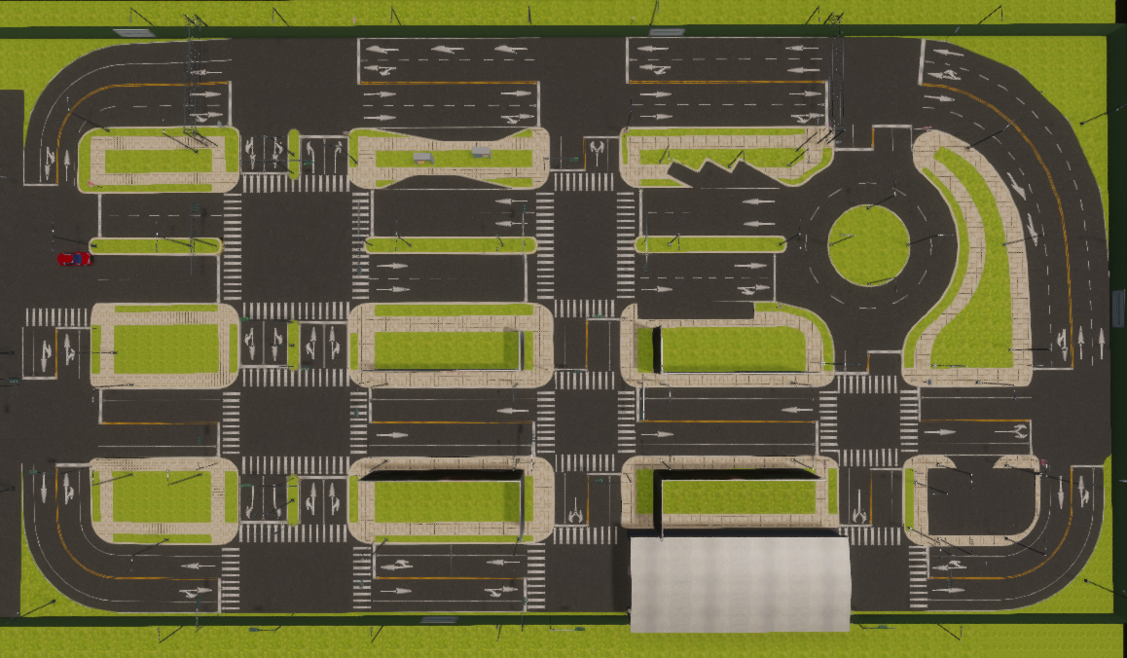
Map
個人賽不分組
Task3
閃避圓環內外線車子
Task6
Task4
閃避對向車
閃避靜態障礙物
Task5
Task2
Task1

Slide 4
Traffic Light (20pt)
Start position: -25.59, -49.80
End position: 78.77, -11.41
Description:
There are two intersections on the path. You need to stop behind stop line when the red light is on.
Score:
5pt: Always drive in correct lane.
15pt: Follow the traffic light correctly.
3*3pt stop in front of stop line when red.
2*3pt start within 2 second after light turns green.

Slide 5
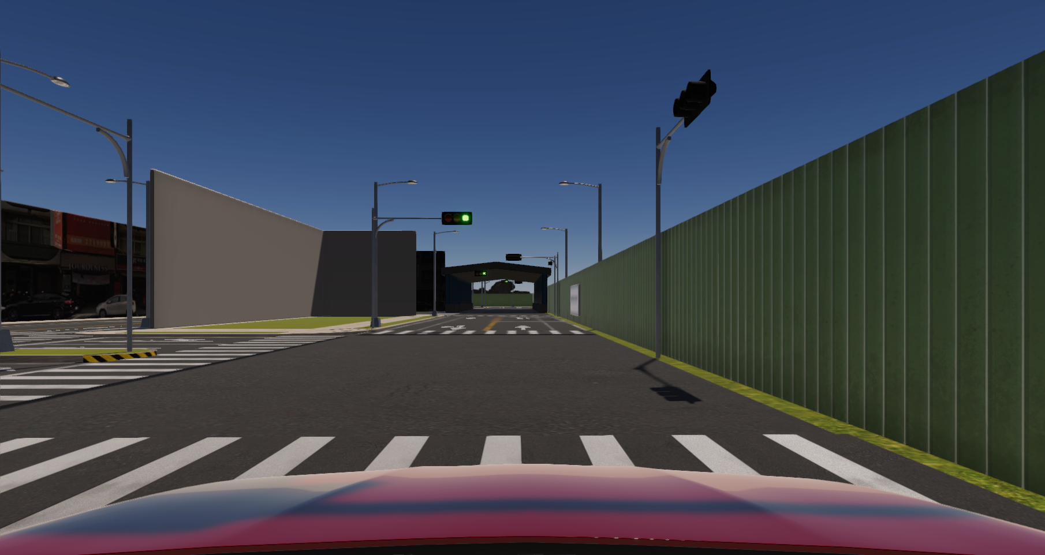
Traffic Light

Slide 6
Curve Road (15pt)
Start position: 78.74, -11.37
End position: 53.64, 61.24
Description:
In this task, you need to turn left and keep in lane
Score:
5pt: Always drive in correct lane.
10pt: Arrive end position and the heading is perpendicular to the stop line.

Slide 7
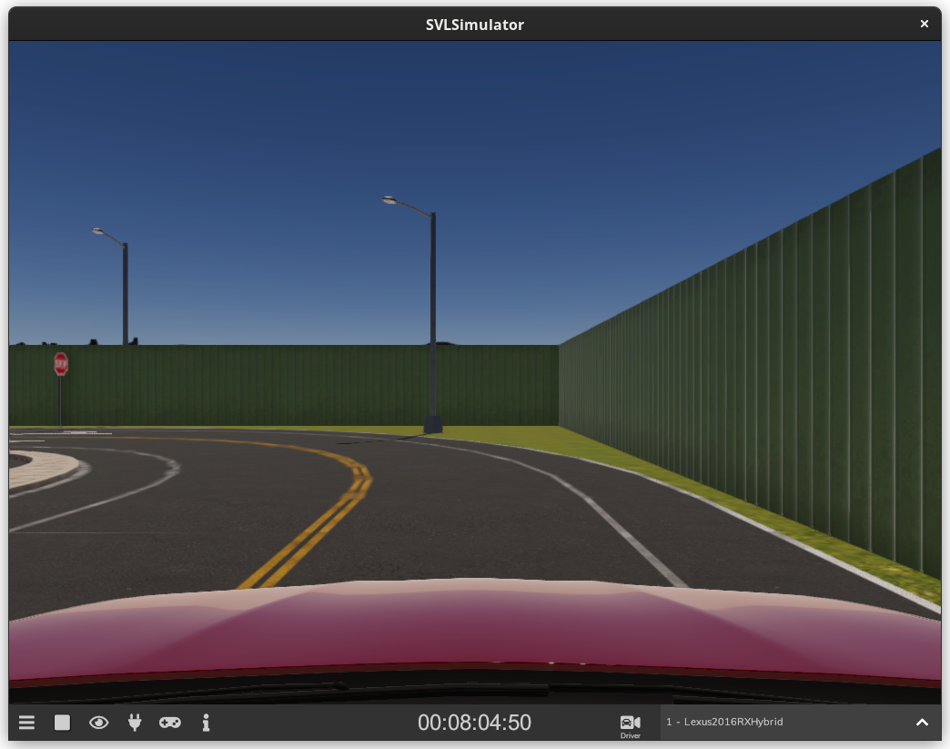
Curve Road

Slide 8
Narrowing driving lanes (20pt)
Start position: 11.41, 50.00
Narrowing point: -26.40, 36.00
End position: -68.19, 2.09
Description:
You need to change to inner lane and drive to the end position.
Score:
10pt: Didn’t drive to the outside of lanes.
10pt: Arrive end position and the heading is perpendicular to the stop line.

Slide 9
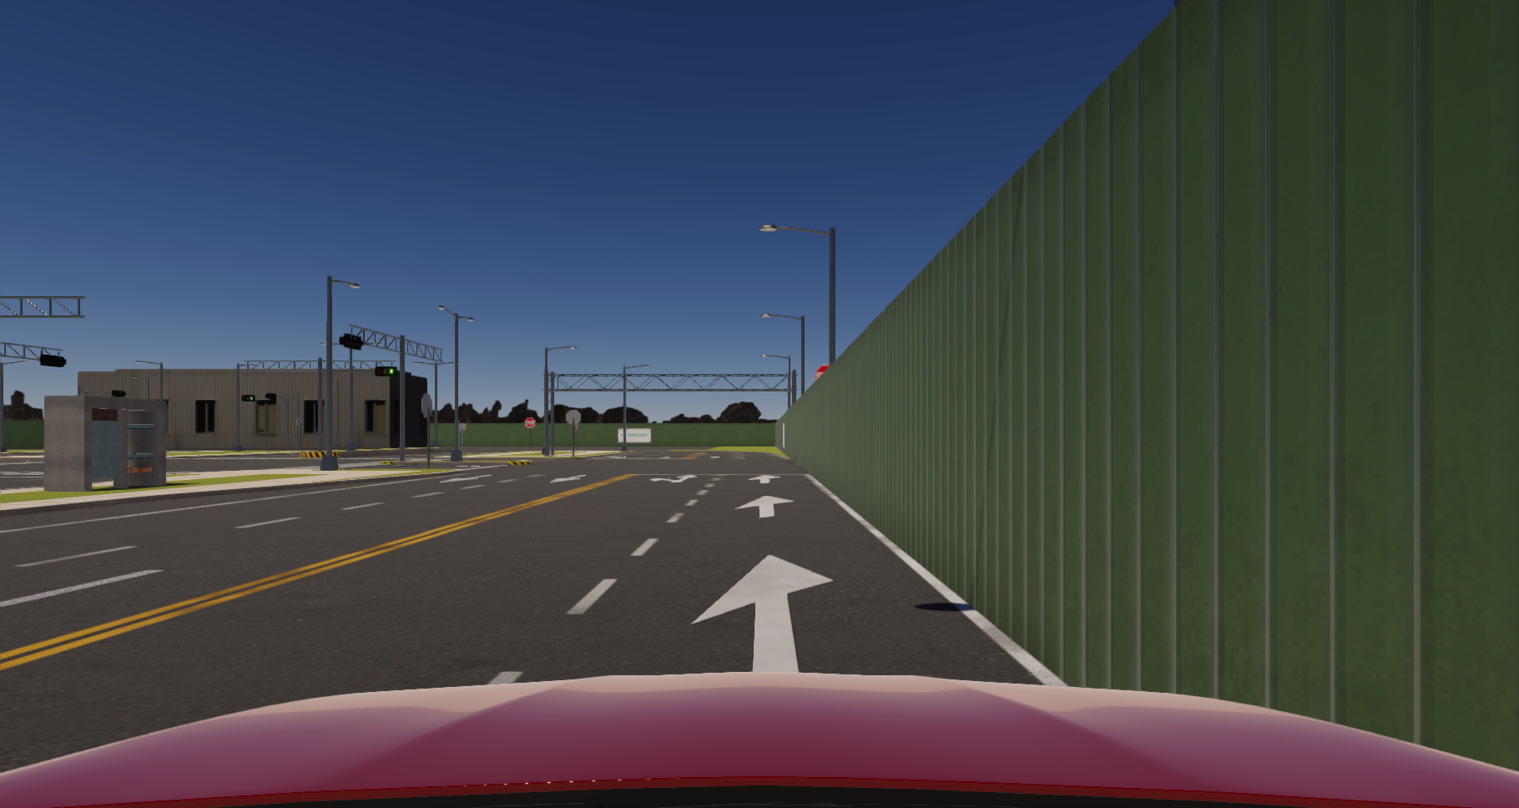
Narrowing driving lanes

Slide 10
T-junction (20pt)
Start position: -68.59, 2.85
End position: -42.16, -4.90
Description:
You need to turn left at the intersection, and avoid opposite traffic.
Score:
8pt: Didn’t hit the safety island.
4pt: Arrive end position and the heading is parallel to the lane.
8pt: Avoid opposite traffic.

Slide 11
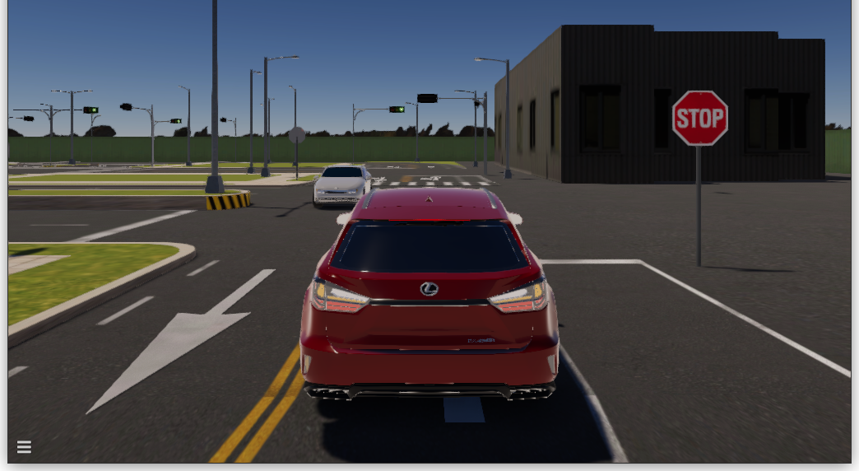
Safety Island
oncoming car
safe island

Slide 12
Roundabout (15pt)
Start position: 35.66, 24.11
End position: 34.90, 36.00
Description:
Drive from start position to end position. The direction of roundabout is counterclockwise.
Score:
5pt: Arrive end position and the heading is parallel to the lane.
5pt: Pass the middle position.
5pt: Always drive in lane.
-5pt: Collision. (NPC disappear after 1 second)

Slide 13
Roundabout
Green: 15pt
Yellow: 10pt
Red: 5pt

Slide 14
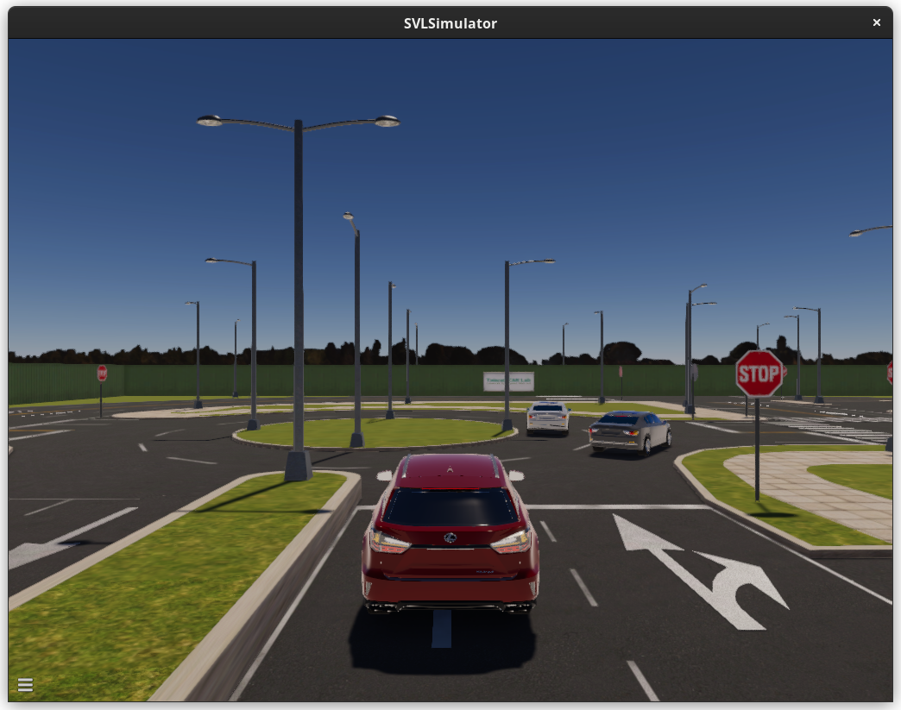

Slide 15
Angled Parking Slots (10pt)
Start position: 36.0, -38.1
End position: 33.4, -23.4
Description:
You need to stop the vehicle in a parking slot.
Score:
5pt: The heading is parallel to the parking slot.
5pt: The vehicle is completely driving outside the lane.

Slide 16
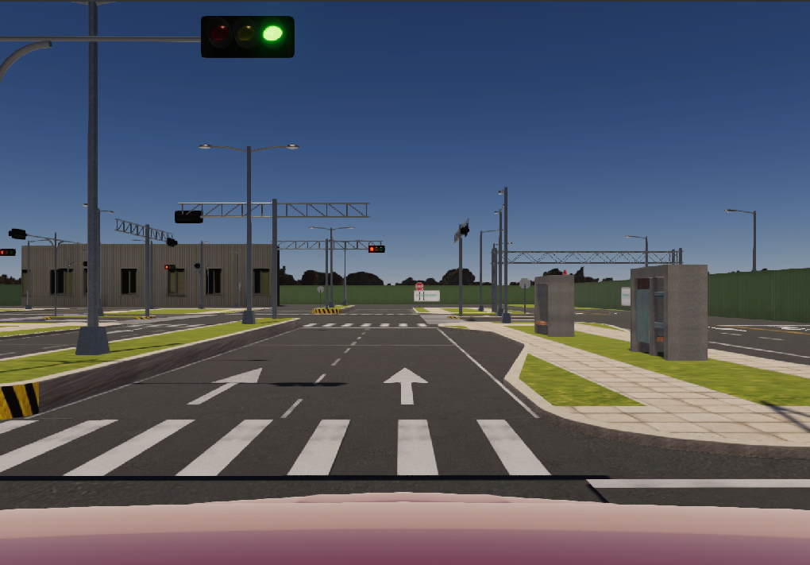
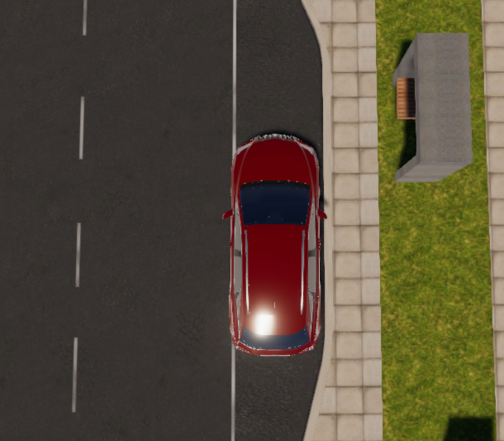
Park in green area: 5pt
Correct heading: 5pt

Slide 17
Demo
Date: 1/11, 1/18 or 1/25
Place: TBA.
Bring your laptop to the classroom or use TeamViewer to control your PC remotely.
You need to record a video during the demo or let TA record it by TeamViewer.
You can also prepare a video of your best tried.

